Slide 1
Lab 4 – jdbc project

Slide 2
Project strategies
Start early
Read specs thoroughly
Take time to work it out

Slide 3
Project design
Intro to JDBC, SQL
UML of spec dependencies

Slide 4
Project overview
Load appropriate driver (for mysql)
Connect to db
Take BankRecord objects array -> store into DB table - > present data to user

Slide 5
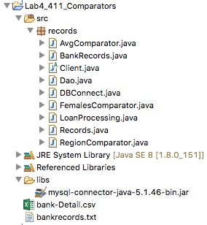
pROJECT package tree

Slide 6
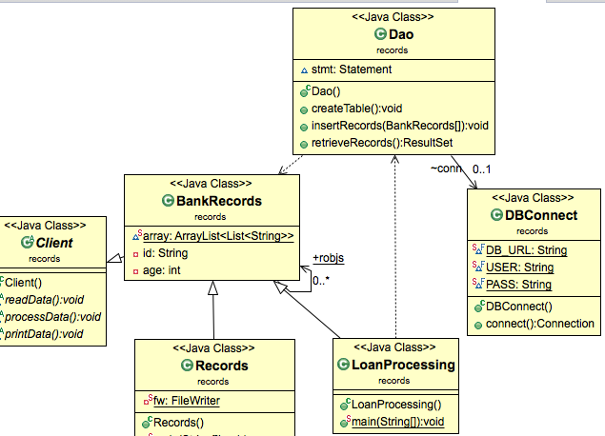
pROJECT class tree

Slide 7

Adding jar file to project’s build path
Create libs folder and add your mysql jar file into the folder

Slide 8
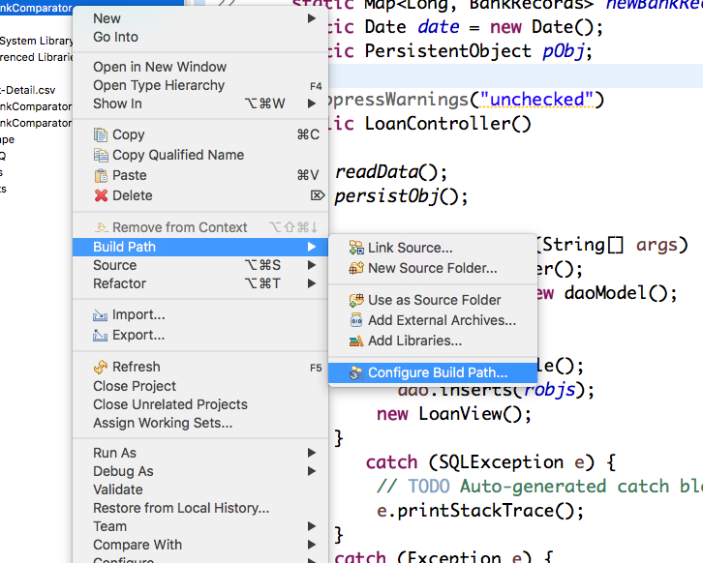
Configure build path
Right click on project & go to Build Path>Confiqure Build Path…

Slide 9
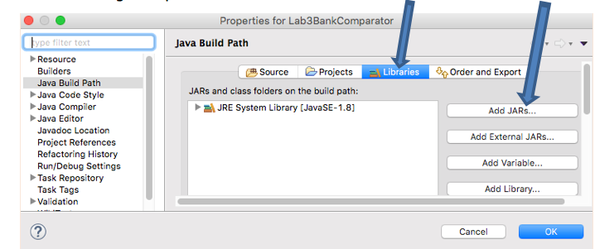
Choose add jaRs…under libraries tab

Slide 10
Apply dry principle for crud operations
Connector class?- Use for opening / closing connections!
Basis: for code reuse
Need driver, connection object declared
Functionality:
getConnection(protocol:subprotocol:url, user,password) method
protocol arg above-> jdbc subprotocol arg above-> msql
url arg above can contain query params-> db, login credentials, connection retries, SSL

Slide 11
iMPORTS for crud OPERATIONS
Needed imports
import java.sql.Connection;
import java.sql.DriverManager;
import java.sql.ResultSet;
import java.sql.SQLException;
import java.sql.Statement;

Slide 12
dbConnect.java
// Setup the connection with the DB for all CRUD methods
DriverManager.getConnection("jdbc:mysql://www.papademas.net:3307
/411labs?user=db411&password=411");

Slide 13
dao.java
Class level object Instantiation
DBConnect conn = null;
Statement stmt = null;
Class constructor
//constructor
public Dao() { // create db object instance
conn = new DBConnect();
}

Slide 14
dao.java (crud METHODS DEFINED)
Create Table method
String sql = "CREATE TABLE yourTableName_tab" +
"(pid INTEGER not NULL AUTO_INCREMENT, " +
" id VARCHAR(7), " +
" income NUMERIC(8,2), " +
" pep VARCHAR(3), " +
" PRIMARY KEY ( pid ))";

Slide 15
dao.java
Create Table method con’t.
Initialize statement
stmt = conn.createStatement();
Execute statement
stmt.executeUpdate(sql);
Closing out connection object
conn.close();

Slide 16
dao.java
Insert Records method
try {
stmt = conn.createStatement();
//Loop thru bankrecord objects
sql= "INSERT INTO yourTableName_tab(field 1,field 2 , field n) " +
"VALUES ( ' "+value 1+" ', ' "+value 2+" ', ' "+value n+" ' )";
stmt.executeUpdate(sql);
//end loop
}

Slide 17
dao.java
Retrieve Records method
public ResultSet retrieveRecords() throws Exception {
ResultSet rs = null;
stmt = connect.createStatement();
String sql = "select * from yourTableName_tab";
rs = stmt.executeQuery(sql);
return rs;
}

Slide 18
loanProcessing.java- dao model executions
Needed imports
import java.sql.ResultSet;
import java.sql.SQLException;
Extends BankRecords class
public class LoanProcessing extends BankRecords { … }

Slide 19
LoanPROCESSING.java
Object instantiations needful for CRUD method executions
BankRecords instance
DAO instance
ex.
BankRecords br = new BankRecords();
br.readData();
Dao dao = new Dao(); //for executing CRUD method from class

Slide 20
loanPROCESSING.java
Trigger CRUD method executions
dao.createTable();
dao.insert(robjs); //perform inserts
ResultSet rs = dao.retrieveRecords(); //fill result set object

Slide 21
loanPROCESSING.java
Cycle through result (record) set
while(rs.next()) { //Extract data from result set
//Retrieve by column id/name
String id = rs.getString(2);
double income = rs.getDouble(3);
String pep = rs.getString(4);
//Display values
}

Slide 22
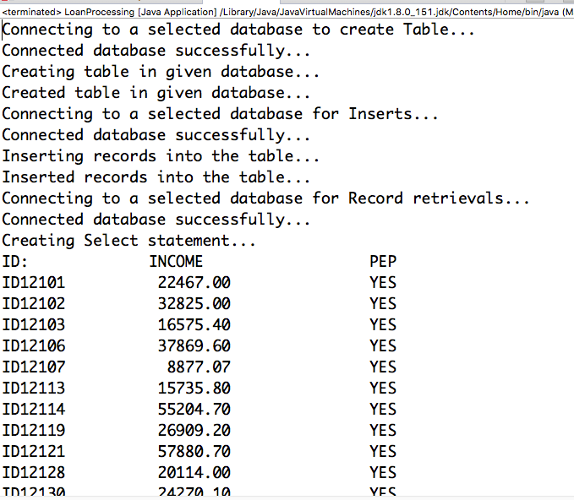
Console Output

Slide 23
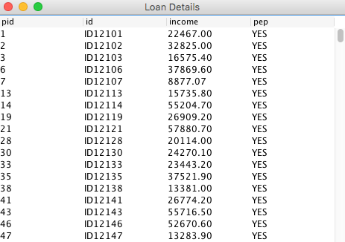
GUI Display- with jTABLE

